Slide 1
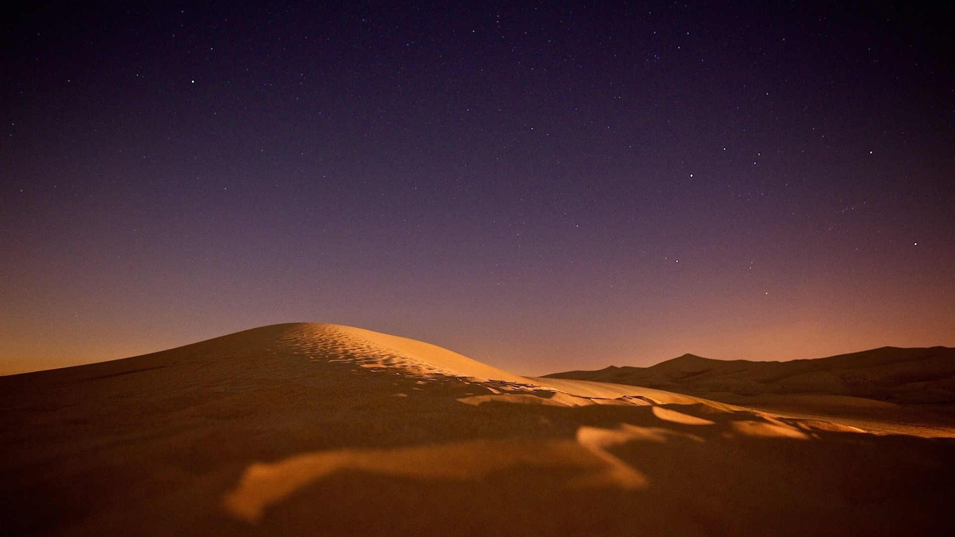
Hungry for His Presence

Slide 2
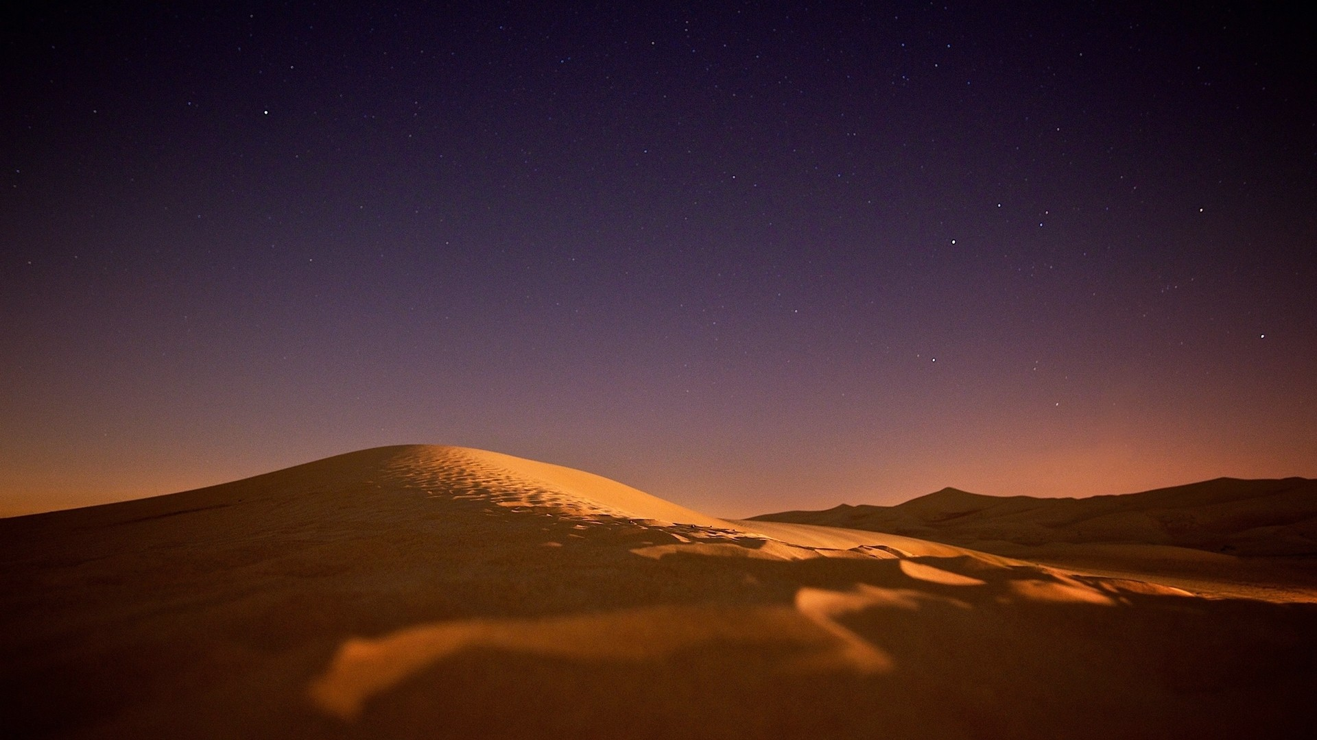

Slide 3

When the cool evening breezes were blowing, the man and his wife heard the Lord God walking about in the garden. So they hid from the Lord God among the trees. Then the Lord God called to the man, “Where are you?”
Genesis 3:8–9
NLT

Slide 5
He replied, “I heard you walking in the garden, so I hid. I was afraid because I was naked.”
Genesis 3:10
NLT

Slide 7
When the people heard the thunder and the loud blast of the ram’s horn, and when they saw the flashes of lightning and the smoke billowing from the mountain, they stood at a distance, trembling with fear. And they said to Moses, “You speak to us, and we will listen. But don’t let God speak directly to us, or we will die!”
Exodus 20:18–19
NLT

Slide 9
It was Moses’ practice to take the Tent of Meeting and set it up some distance from the camp. Everyone who wanted to make a request of the Lord would go to the Tent of Meeting outside the camp. Whenever Moses went out to the Tent of Meeting, all the people would get up and stand in the entrances of their own tents. They would all watch Moses until he disappeared inside. As he went into the tent, the pillar of cloud would come down and hover at its entrance while the Lord spoke with Moses. When the people saw the cloud standing at the entrance of the tent, they would stand and bow down in front of their own tents. Inside the Tent of Meeting, the Lord would speak to Moses face to face, as one speaks to a friend. Afterward Moses would return to the camp, but the young man who assisted him, Joshua son of Nun, would remain behind in the Tent of Meeting.
Exodus 33:7–11
NLT

Slide 11
Teach these new disciples to obey all the commands I have given you. And be sure of this: I am with you always, even to the end of the age.”
Matthew 28:20
NLT

Slide 13
If you look for me wholeheartedly, you will find me.
Jeremiah 29:13
NLT

Slide 15
Hungry for His Presence

